Slide 1


Design and Implementation of In-situ Human-Elephant Conflict Management System
Presented by:
S. Jagannathan,
M.E-VLSI Design & Embedded systems,
MIT campus, Anna University.

Slide 2
Introduction
India hosts 60% of Asian elephant population, nearly two-thirds of the elephant population lives either close to or within human-dominated landscapes.
Elephant Corridors:
● 88 - Total corridors in India.
● 90% - Corridors in Rest of India are Protected.
● But, 65% - Corridors in South India are Protected.
As of 2013, Asia’s elephant population has experienced a 90% decline in the past 100 years.
Main reasons for Human-Elephant conflict are
● Due to conversion of the forest lands into human settlements.
● The shortage of resources such as water and food.
1

Slide 3
Introduction(contd.)
Traditional measures:
● Lighting fires, flashing torch lights on eyes of an elephants, drum beating, exploding firecrackers, chilli bombs or Electric fences.
Extreme case, using guns and spears to frighten or inflict pain on the elephants.
Usage of seismic geophones:
● Sensors which are buried under the ground to detect the movements of elephants in forest border areas.
● Insufficient vibrations sensed by the geophones during like rain and soil moisture.
● Due to this, it may miss the to detect elephant movement.
2

Slide 4
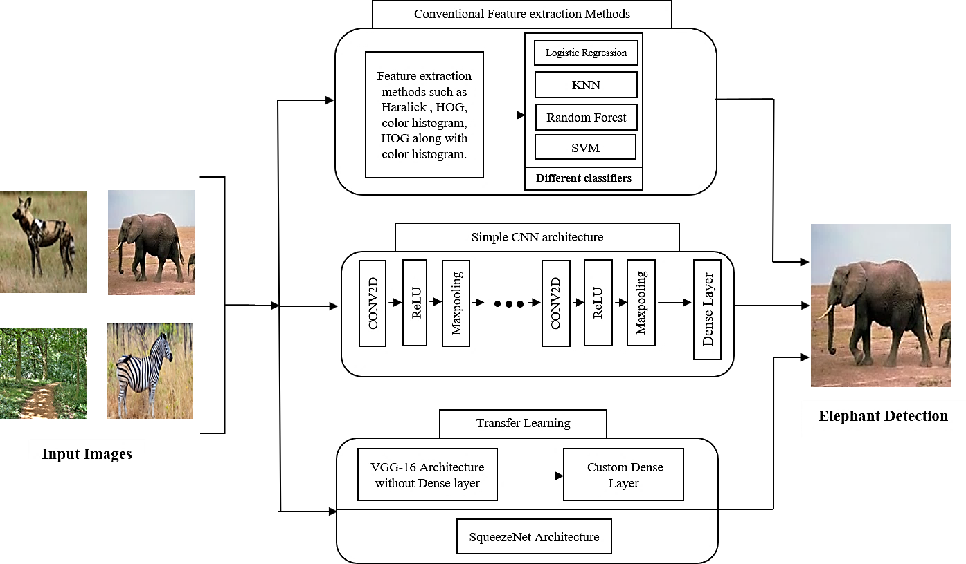
Methodology

Slide 5

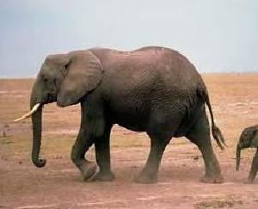
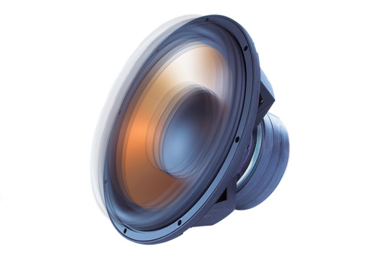
Overall Block Diagram of Proposed System
Feature extraction
(SqueezeNet)
Classifier
(SqueezeNet)
camera
Raspberry Pi
Video feeds
Elephant Detected
Mic Socket
Sound Generation
(Classifiers)
Speaker
14

Slide 6
Dataset Preparation
Dataset of 2210 elephant images and 2600 non-elephant images combining 4810 images is collected.
Images are preprocessed, here all the images are resized within 150x150 pixels.
The dataset is further augmented in order to improve the accuracy of the model.
The augmented dataset containing 5120 elephant images and 5530 non elephant images combining to form dataset of 10,650 images.
For squeezenet, the dataset is further increased by 7400 elephant images and 7470 non elephant images combining to form 14,870 images.

Slide 7

Conventional Methods

Slide 8
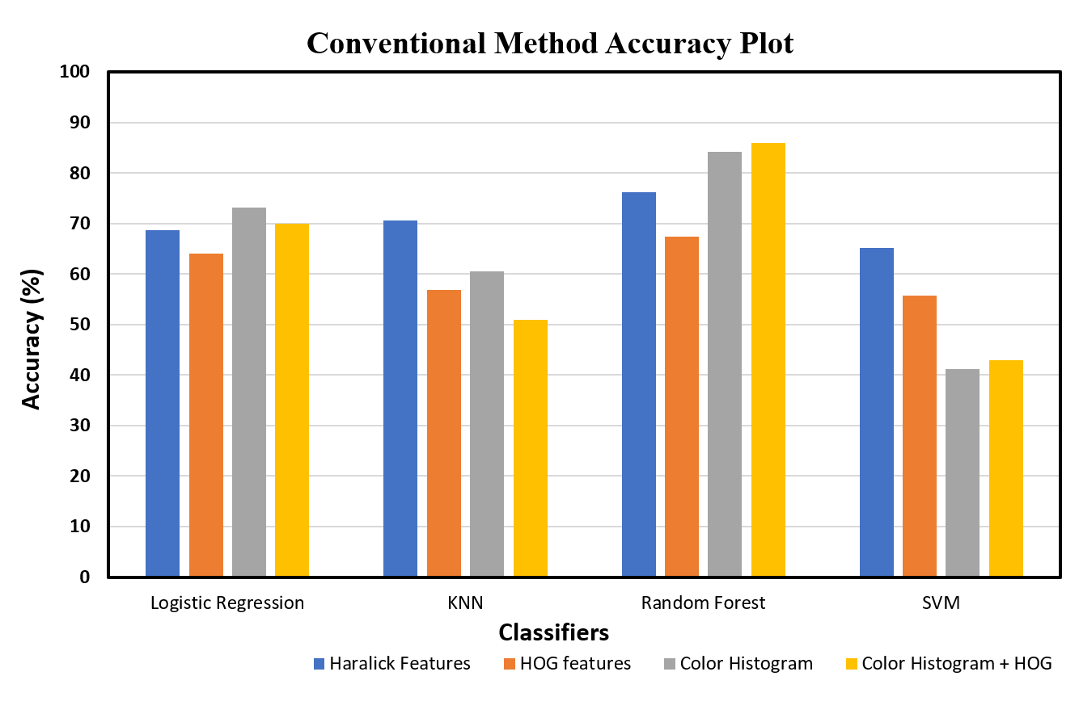
Conventional Method Result

Slide 9
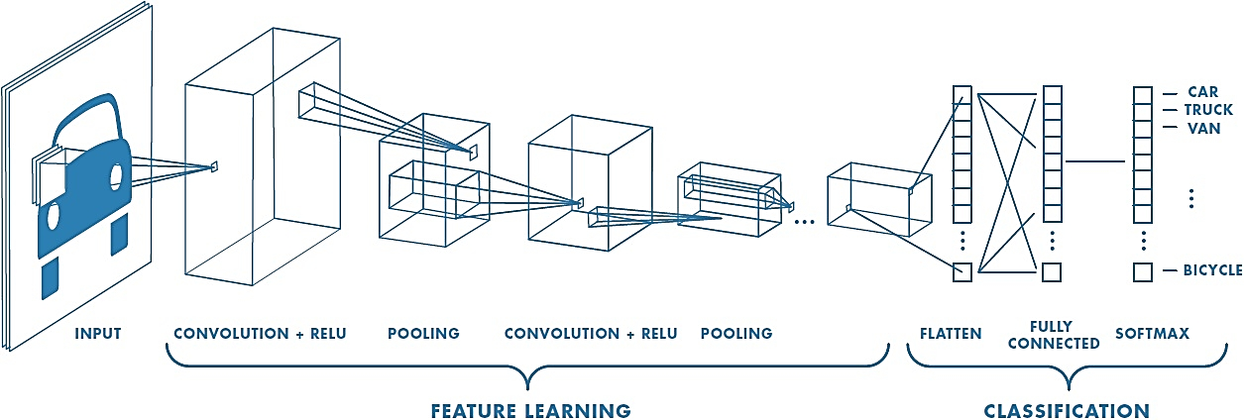
Convolutional Neural Networks (CNN)
CNN layers: Overview

Slide 10
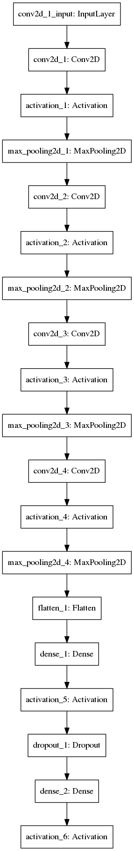
Architecture of Custom CNN model

Slide 11
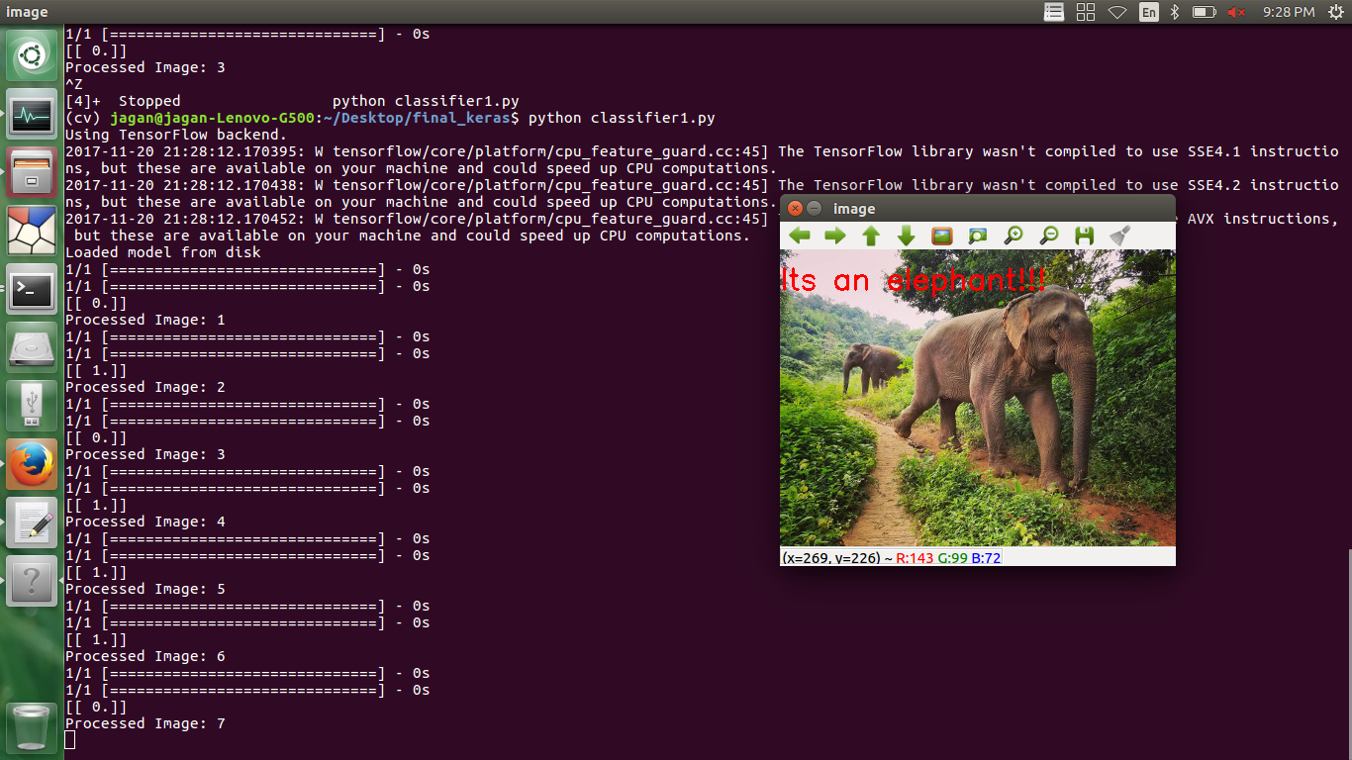
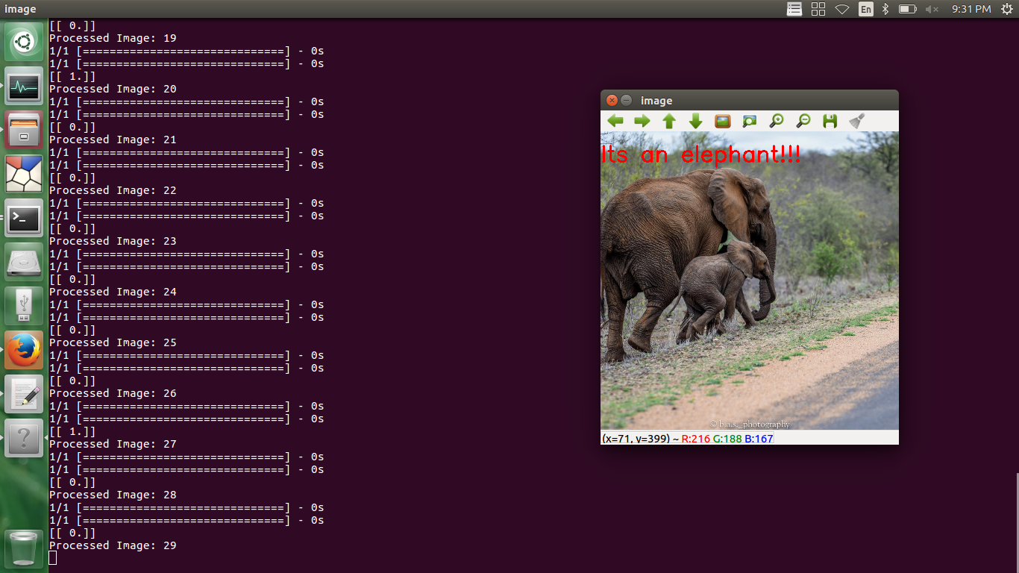
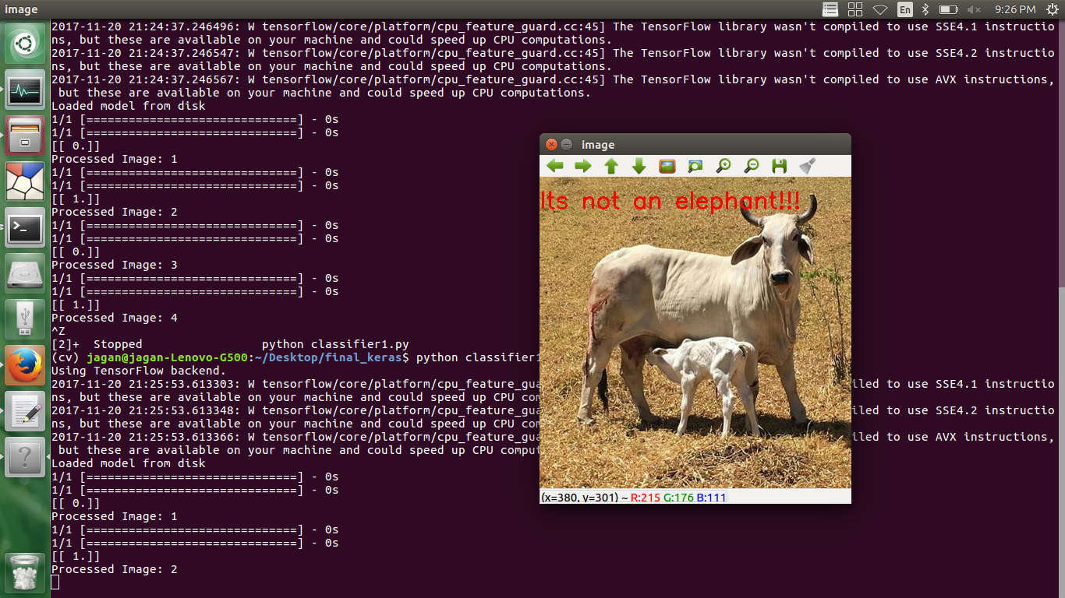
Output

Slide 12
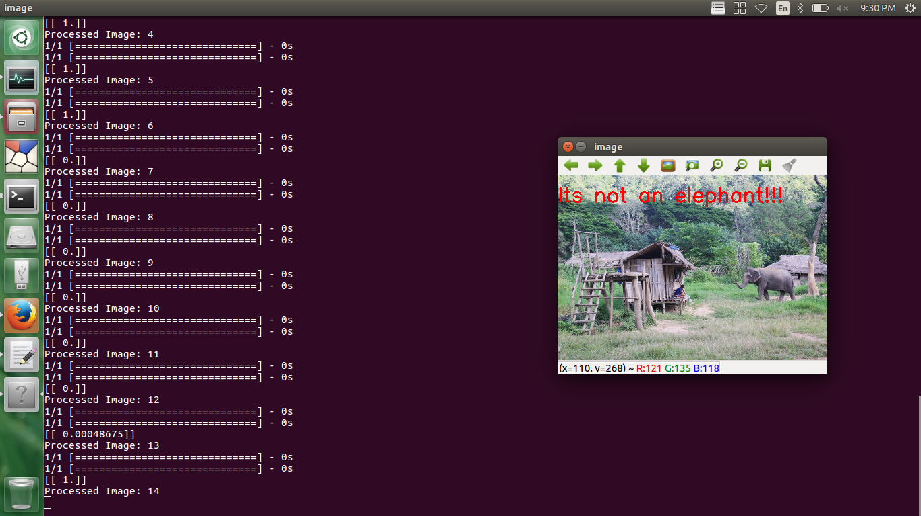
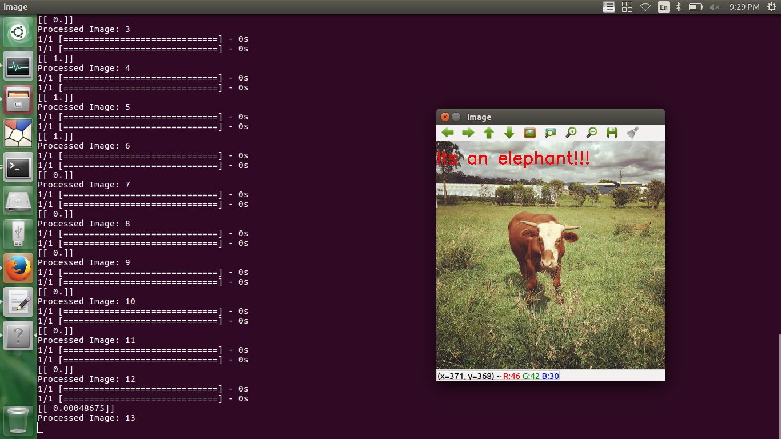
Wrong Detections

Slide 13

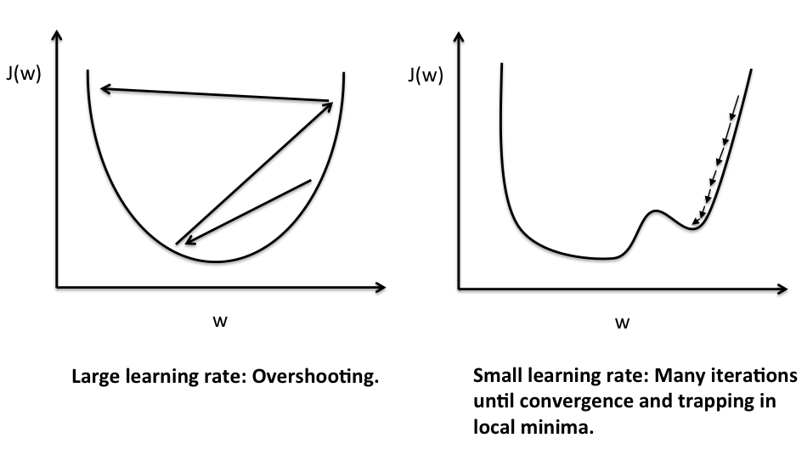
Improving the accuracy
Experimenting with the Hyper-Parameters
Learning Rate (α)
Iterations
Hidden layers
Optimizer
Loss function
Activation Functions and so on…

Slide 14
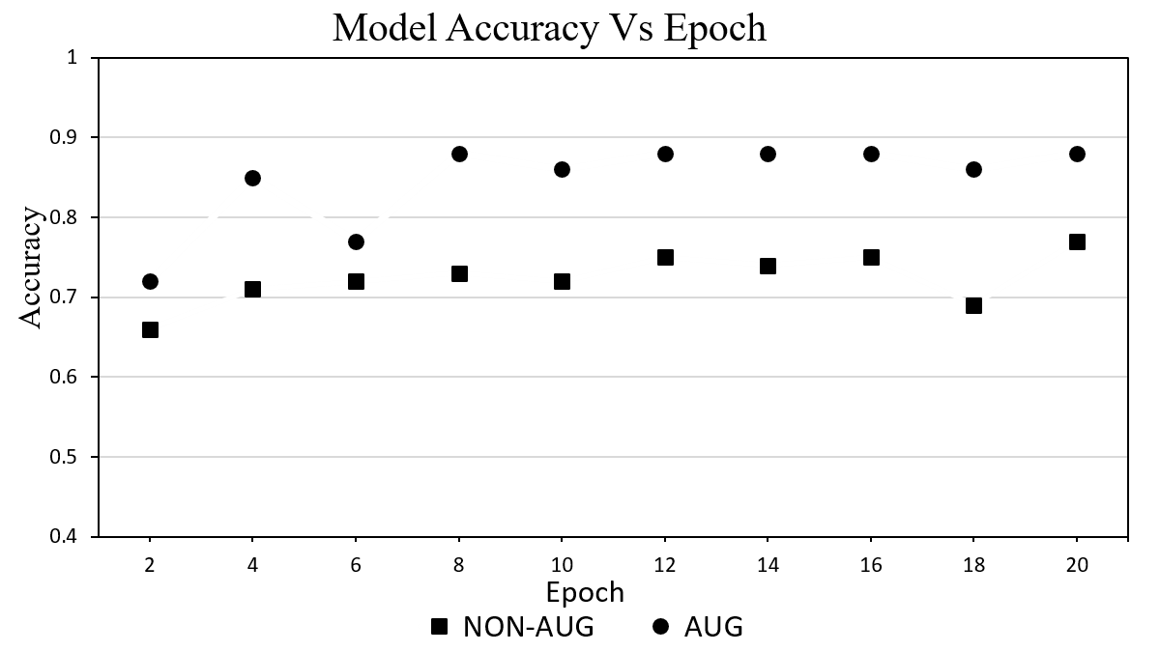
Improving the accu racy
Large Dataset results in increased accuracy.
Non- augumented Dataset contains 4810 images.
Augumented Dataset contains 10,650 images.

Slide 15
Difficulties while designing new architecture
Weight tuning
Random weight initialization.
Tuning the weights requires,
Large data needed to fine-tune the weights.
Large data means Larger training time and higher hardware resources needed to train the neural networks.
But larger the data, higher the accuracy.
Weight tuning will takes more time and more data.
Data size Accuracy Training Time hardware resources

Slide 16
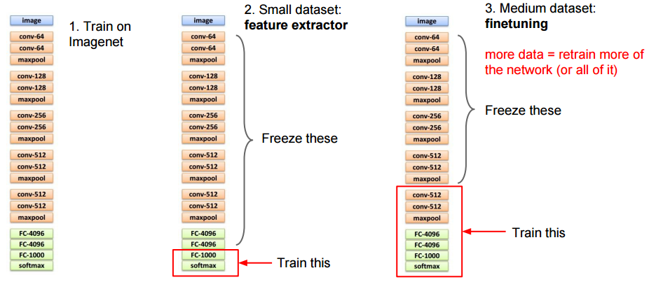
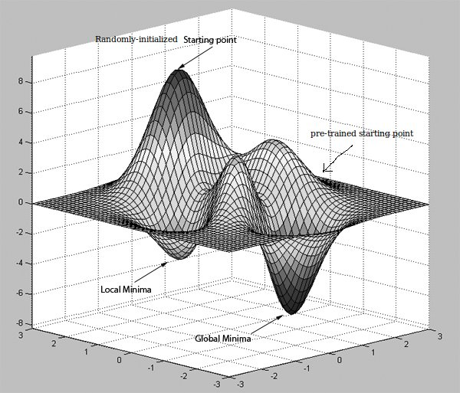
Transfer Learning in CNN
Transfer learning methods depends on dataset
Weight Initialization

Slide 17
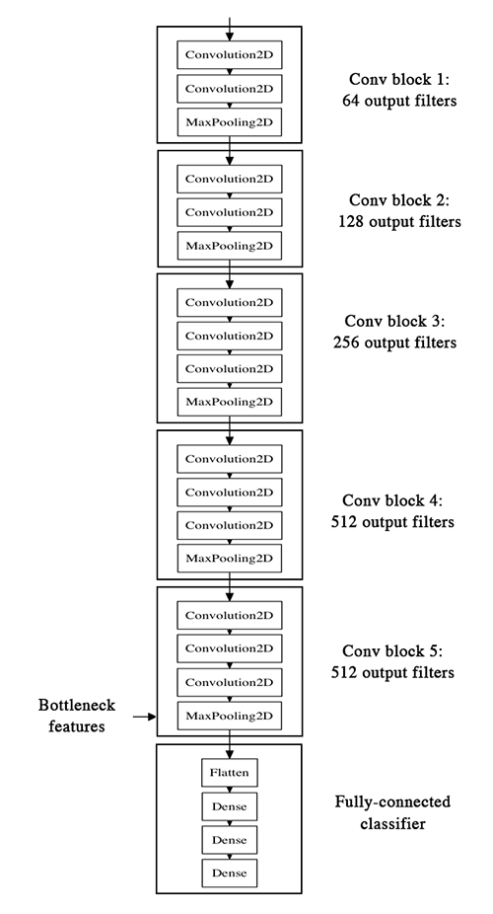
Transfer Learning in CNN
We get a pre-trained model (with the weights loaded) and remove final fully-connected layers from that model.
We then use the remaining portion of the model as a feature extractor for our smaller dataset.
These extracted features are called "Bottleneck Features" (i.e. the last activation maps before the fully-connected layers in the original model).
We then train a small fully-connected network on those extracted bottleneck features in order to get the classes we need as outputs for our problem.
By this method, got an accuracy of 94%.
VGG-16 architecture

Slide 18
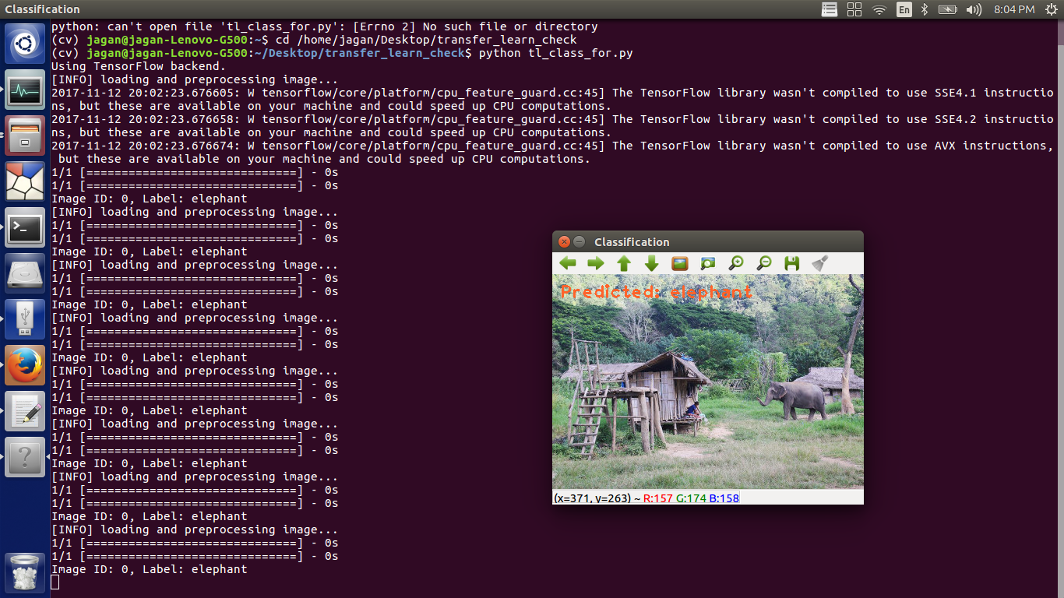
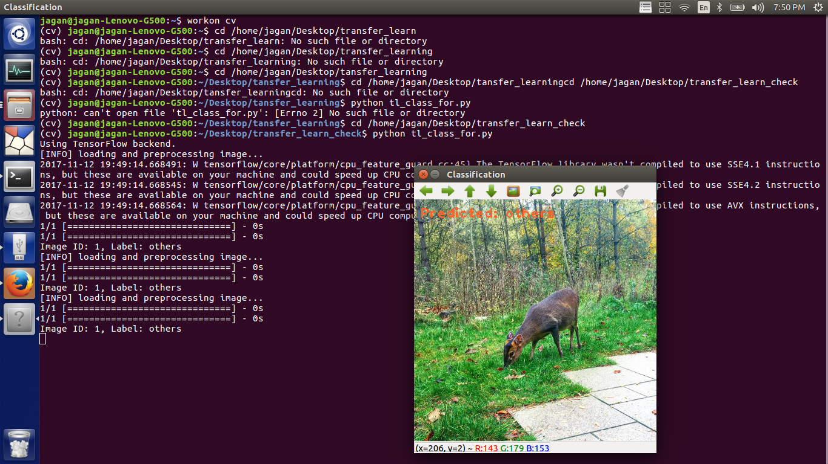
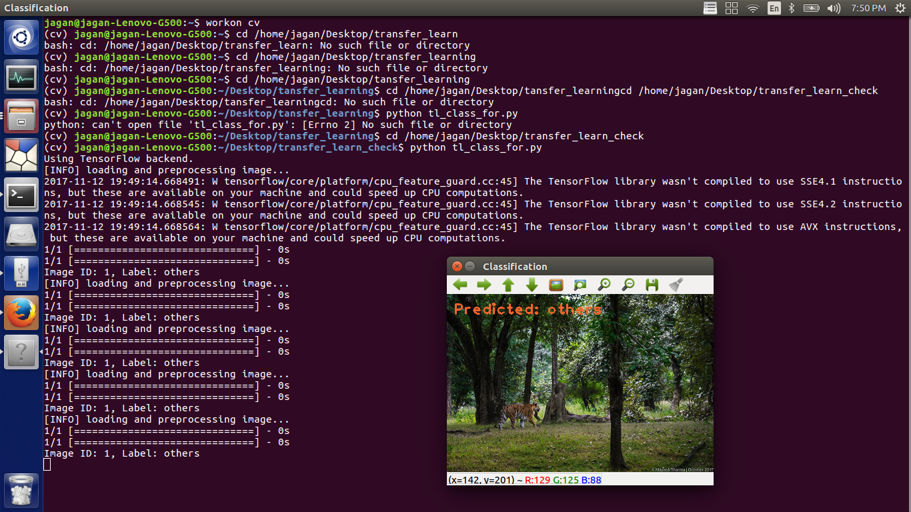
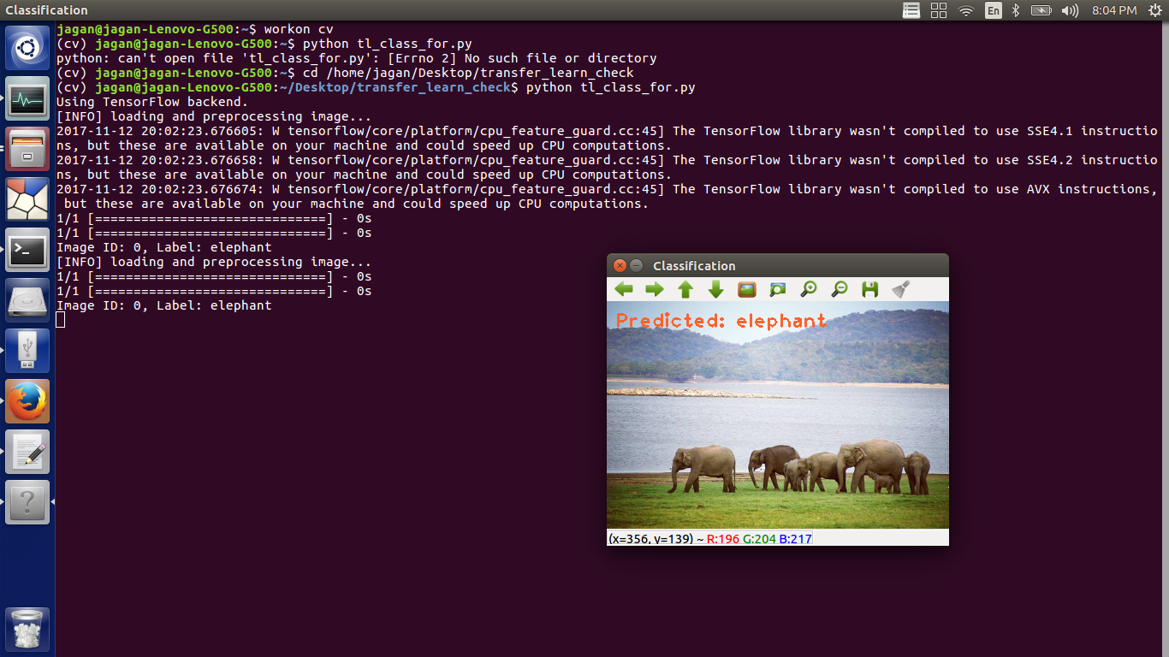
Image Classification

Slide 19
SqueezeNet Architecture
The SqueezeNet model initially has the single convolution layer having 64 filters with the stride of 3x3.
It is followed by 8 layer of fire module. The fire module comprises of two parts such as Squeeze Layer and Expand layer. The squeeze layer consists of only 1x1 filters and expand layer consist of both 1x1 layer and 3x3 layer.
Each convolution layer is followed by ReLU activation function. Then Maxpooling with stride 2 is applied as shown in the architecture.
At the bottom of the model global Average pooling is used.
Softmax is used to get the output prediction in probability values.

Slide 20
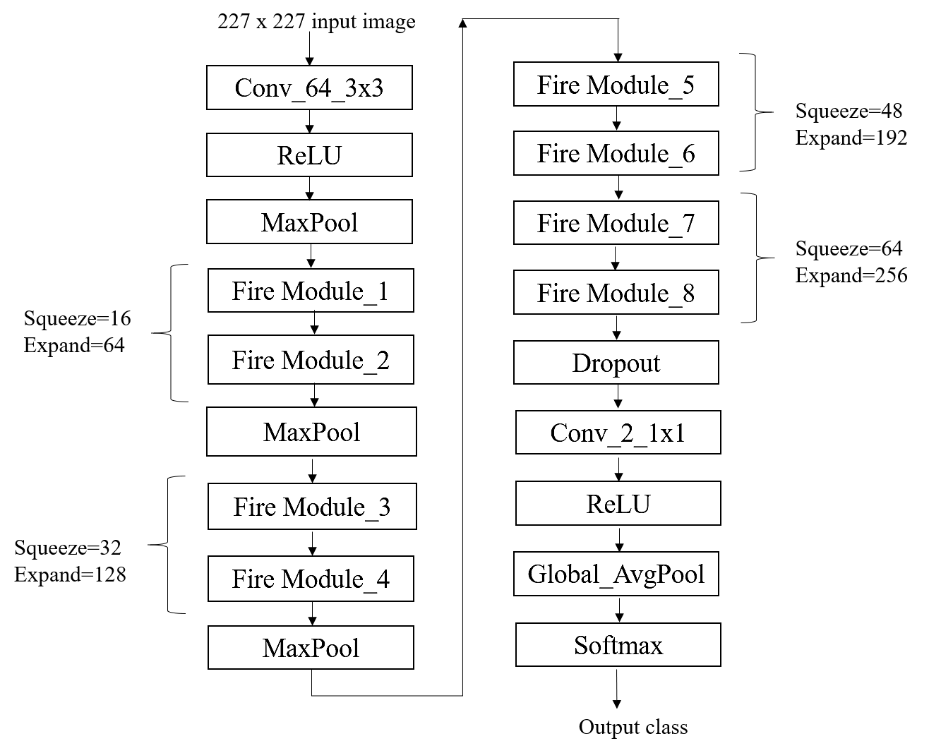
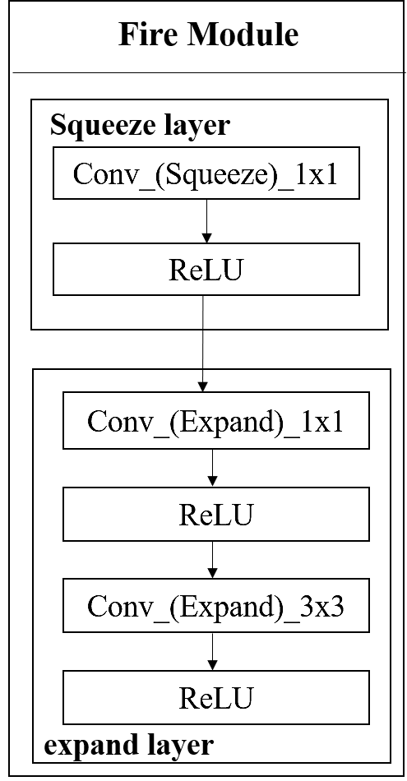
SqueezeNet Architecture
Fire Module
Overall architecture

Slide 21
SqueezeNet Architecture
To reduce model size,
Make the network smaller by replacing 3x3 filters with 1x1 filters.
Using 1x1 filters will reduce the number of parameter to learn, this will reduce computation resulting in faster prediction.
Reduce the dimension of the image in later stages of the network so that convolution layers have large activation maps.

Slide 22
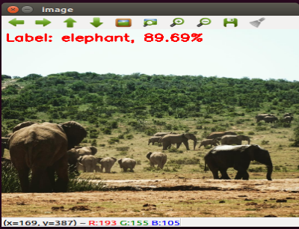
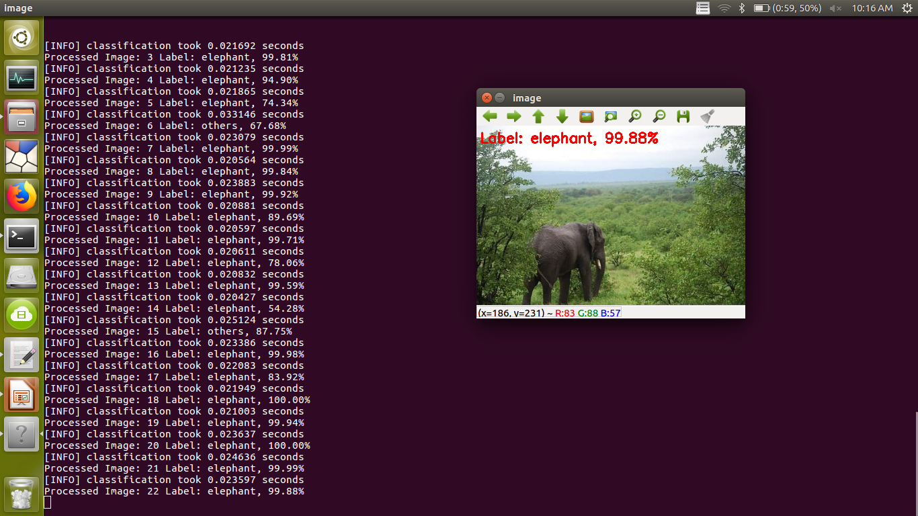
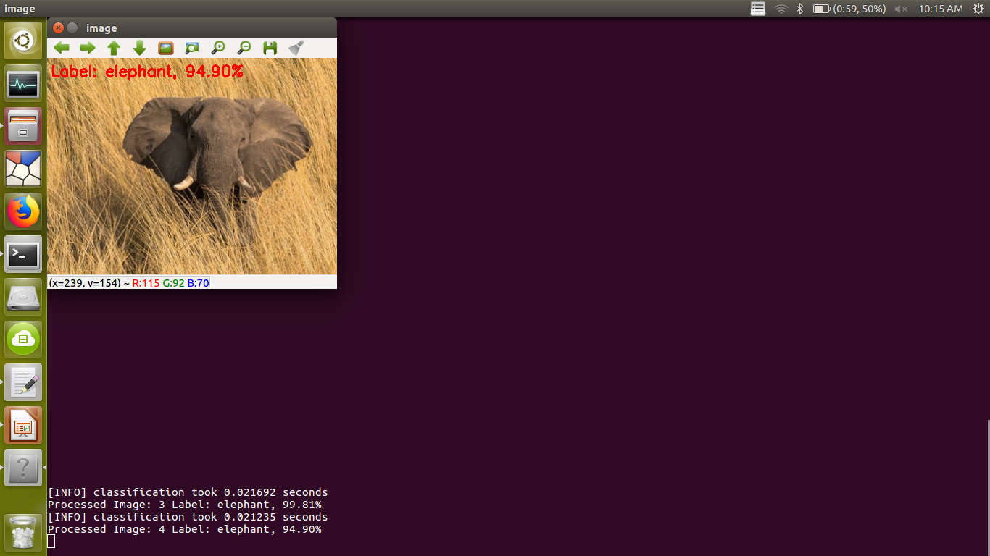
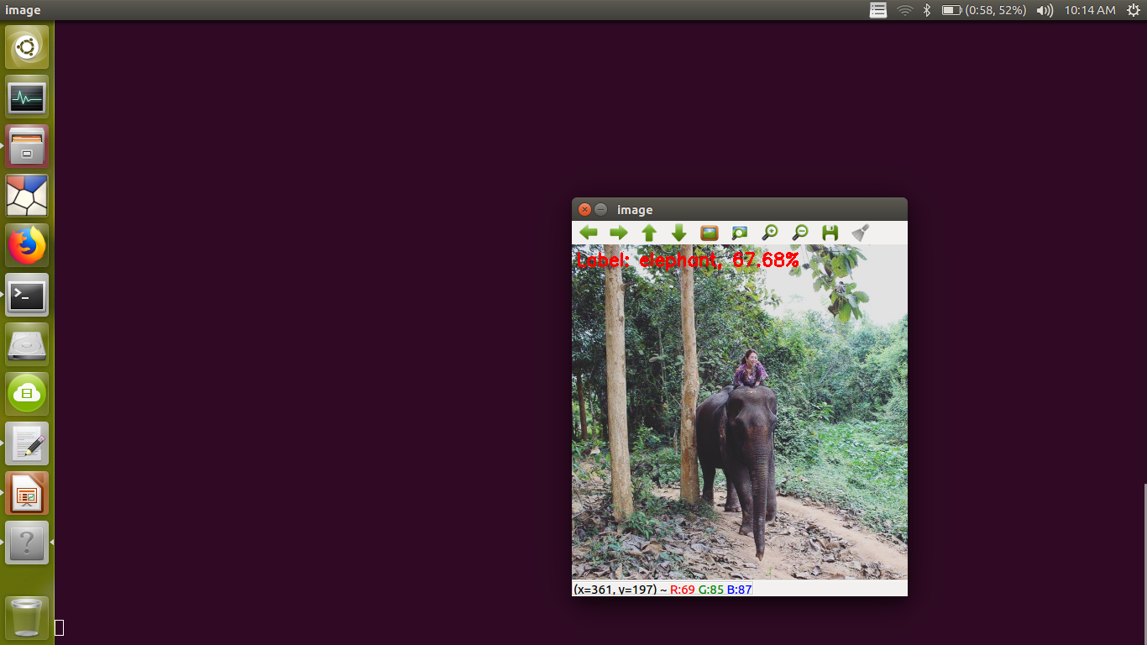
Image Classification using SqueezeNet
Elephant class

Slide 23
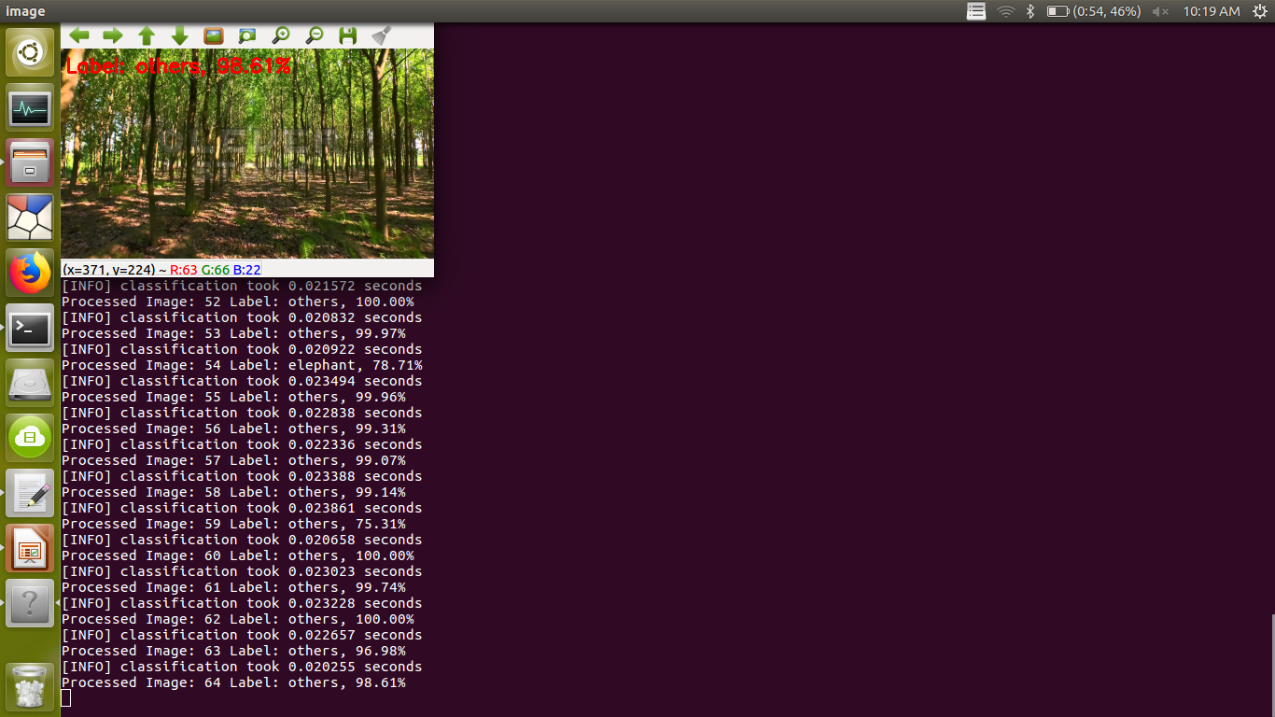
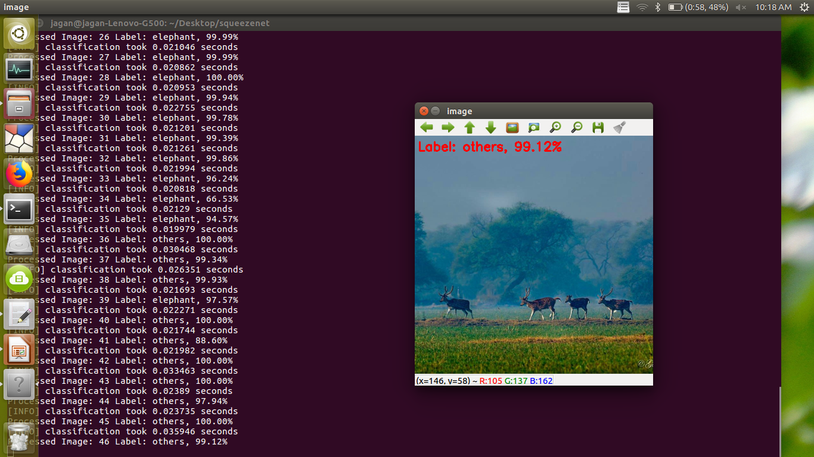
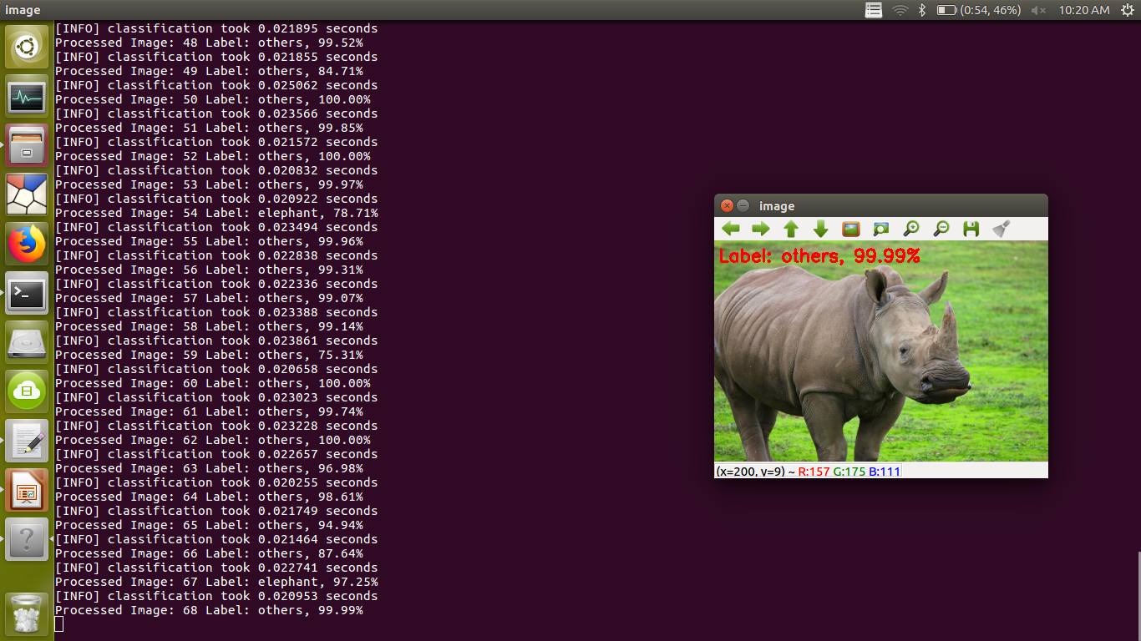
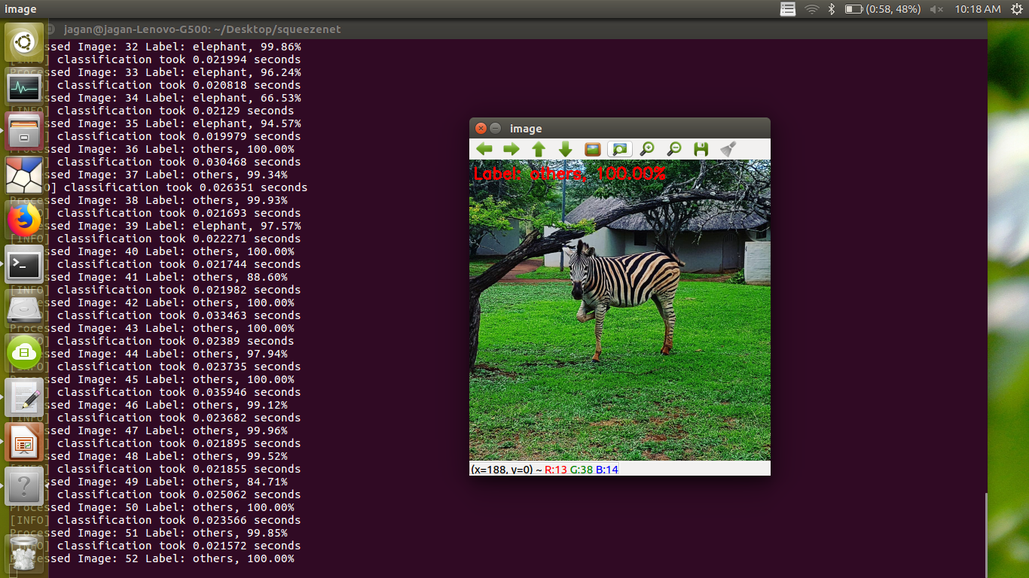
Image Classification using SqueezeNet
Others class

Slide 24
Advantage of SqueezeNet model
Architecture | Accuracy | Size of Weight file | Prediction time (s)
Conventional Methods | 86% | 26 MB | 0.3 to 0.8
Custom CNN | 88% | 14.4 MB | 0.3 to 0.6
Transfer Learning
VGG-16 | 94% | 84.5 MB | 1.8 to 2.1
SqueezeNet | 92.67% | 2.9 MB | 0.02 to 0.05

Slide 25

Processing Videos
.
Continuous Display of processed frames
SqueezeNet architecture
frames
frame-n
frame-2
frame-1
Camera
Overview of processing video feeds using SqueezeNet

Slide 26
Implementation in Raspberry Pi-3
Few Specifications
OS: Raspbian OS
processor: Quad core @1.2 GHZ processor
RAM : 1GB RAM
It has built-in Audio jack.
Intex IT-305WC 5 MP camera with frame rate of 30fps is used.
Device | Detection time (s)
Lap -i3 quad core | 0.03
Raspberry Pi3 | 0.2

Slide 27
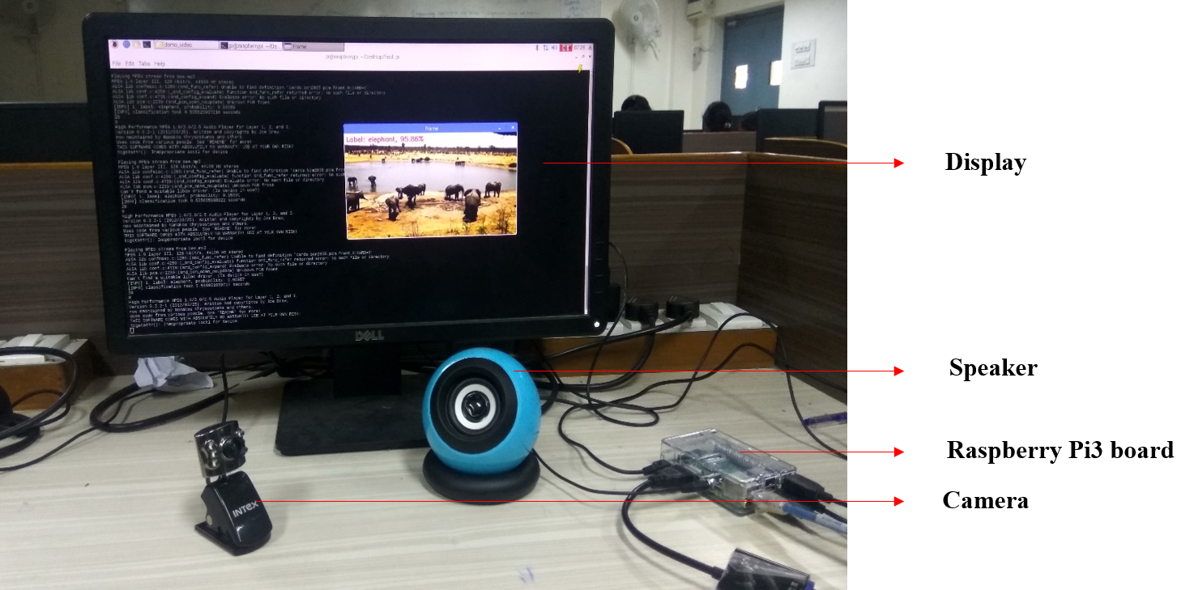
Prototype using Raspberry Pi-3

Slide 28
Thank You

Slide 29
Text to voice converter
import win32com.client as win
speak = win.Dispatch("SAPI.SpVoice")
a="This is I P C V M L workshop, which is held every year.“
speak.Speak(a)

